Slide 1
VEHICLE NUMBER PLATE DETECTION
Made by:-
Rishabh Gupta
Shivam Darmora
Shikhar Gupta

Slide 2
INTRODUCTION
Project is all about to read the Vehicle License number .
In this the image of vehicle number plate is captured and then vehicle license number is extracted from it and converted into text.
It is done with the help of various Softwares like Open CV , PyTesseract etc.

Slide 3
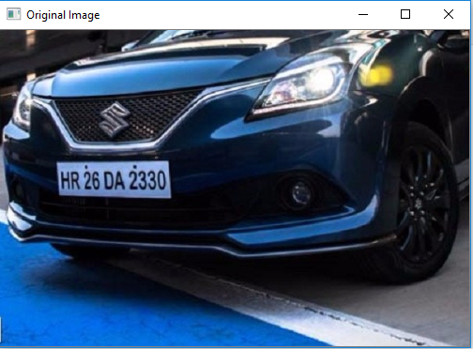
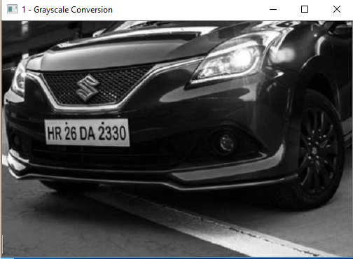
STEPS OF WORKING
STEP 1: Select an image on which processing is to be done.
STEP 2: Convert the image to grayscale image(Grayscale Conversion).
Grayscale images, a kind of black-and-white or gray monochrome, are composed exclusively of shades of gray. The contrast ranges from black at the weakest intensity to white at the strongest

Slide 4
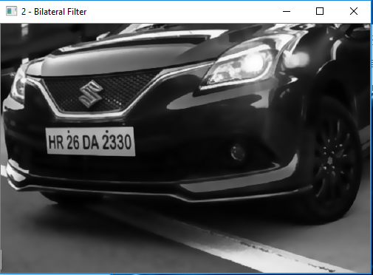
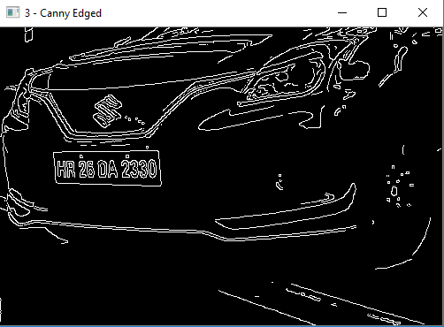
STEP 3: Apply bilateral filter to image.
STEP 4: Apply Canny Edged to image.
A bilateral filter is a non-linear, edge-preserving,and noise-reducing smoothing filter for images. It replaces the intensity of each pixel with a weighted average of intensity values from nearby pixels.

Slide 5
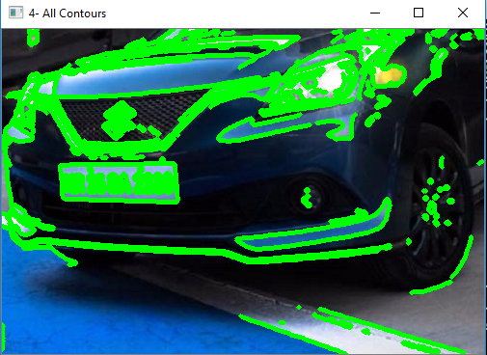
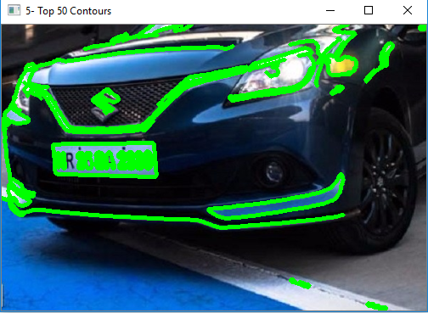
STEP 5: Calculate all contours of image.
STEP 6: Calculate top 50 contours of image.

Slide 6


STEP 7: Image after detection.
STEP 8: Fetching Number after
detection from an image.

Slide 7
APPLICATIONS
This is also used to surveillance the area to keep track of every vehicle and making the process easier . Eg:Parking Area
It helps in analysing the busy routes of city/town. As it help the government to develop the surrounding area around it.
It help to develop the area around which the density of similar types of state cars. Like:Tourists spot
This mechanism can also be used along with traffic light system .If a vehicle crosses the red light. It capture the image and send the vehicle number at police station/headquarters.

Slide 8
THANK YOU !

